Slide 1
Spatial Analysis of Historical Data in London
Exploring the spread of cholera through spatial means and weighted analyses

Slide 2
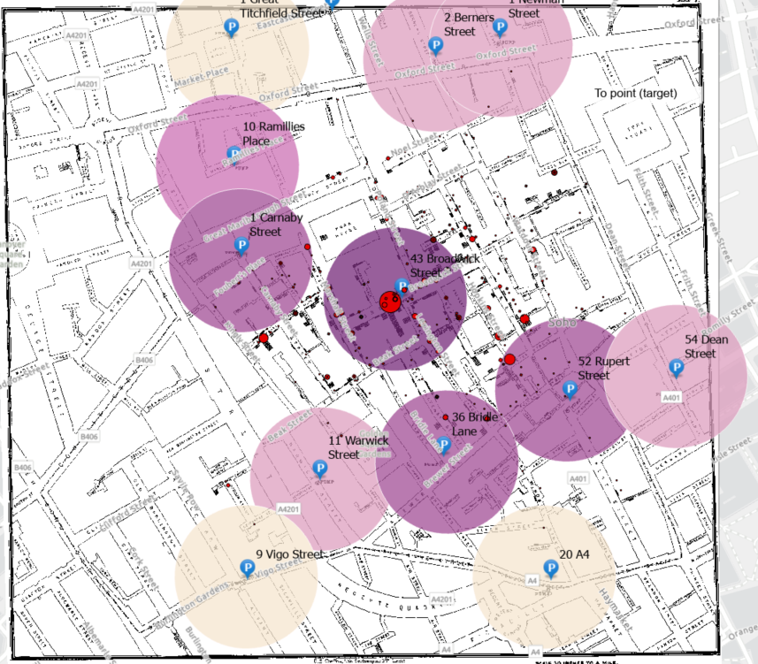
Water Pumps and Case Locations
Buffer
Pumps Buffer - proximity to water pumps played role in spread of cholera

Slide 3
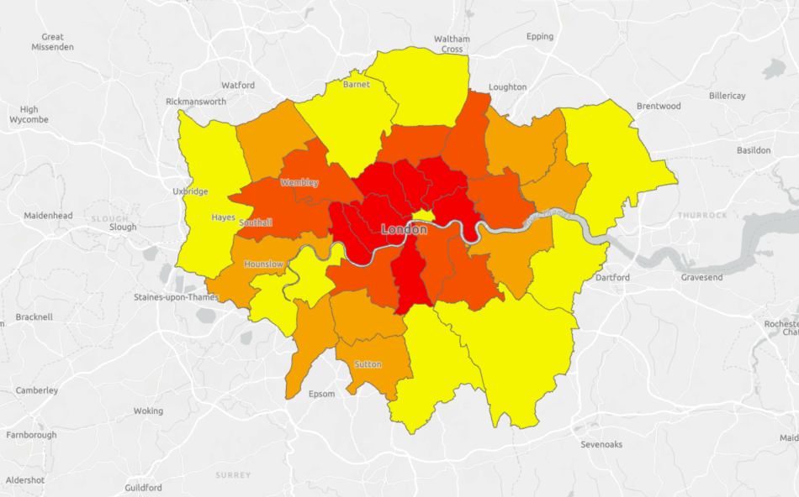
Population Density of London
Population density can affect spread of Cholera

Slide 4
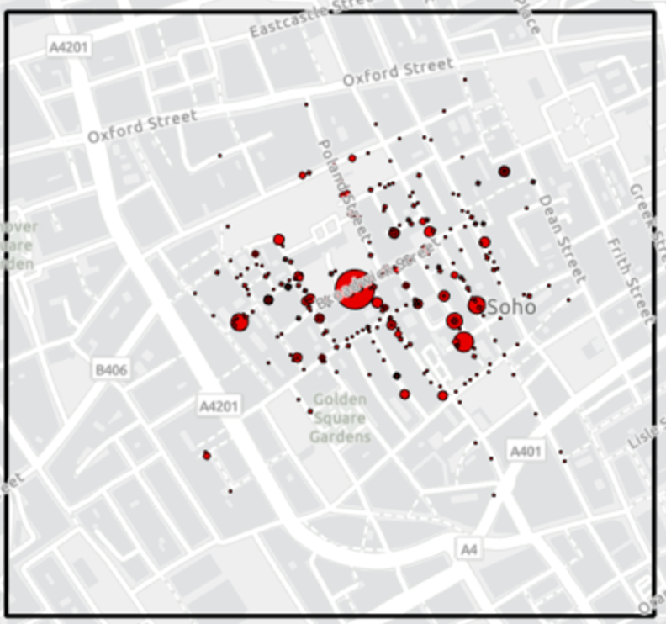
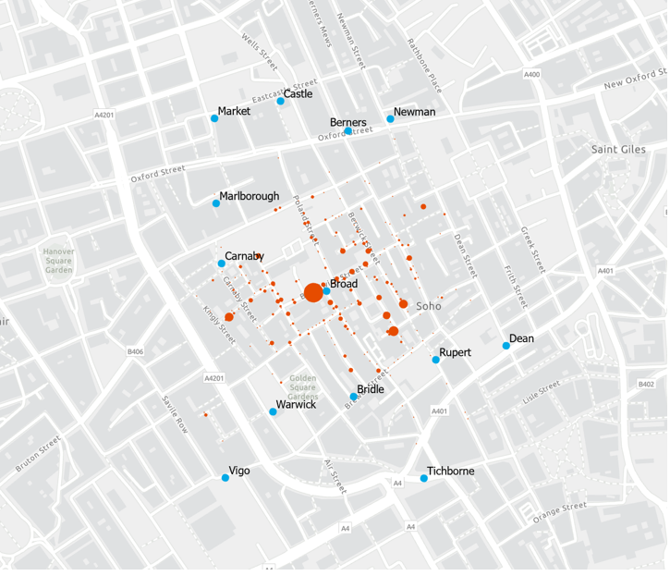
Death Cases in London

Slide 5
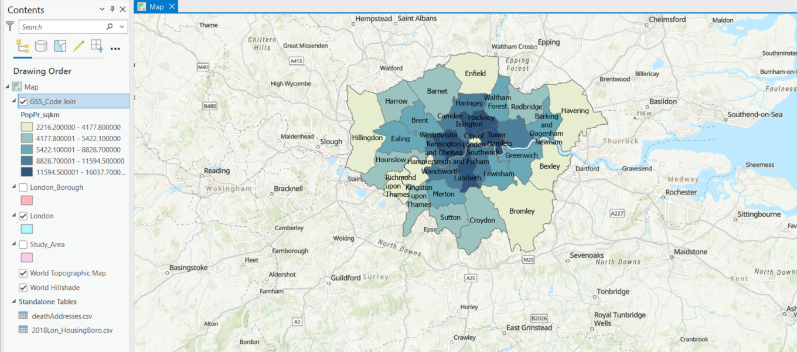
Spatial Joins & Labeling
09.17.XX
1013.XX
10.20.XX
11.01.XX

Slide 6
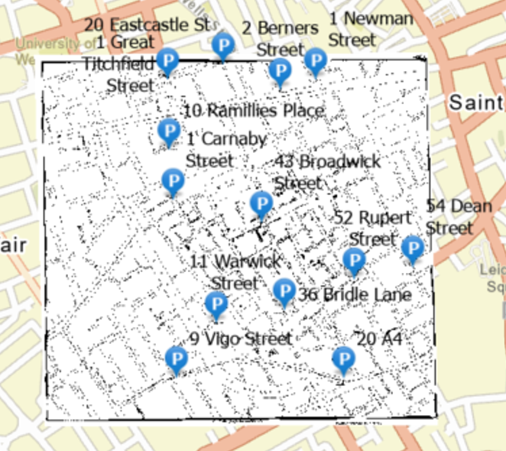
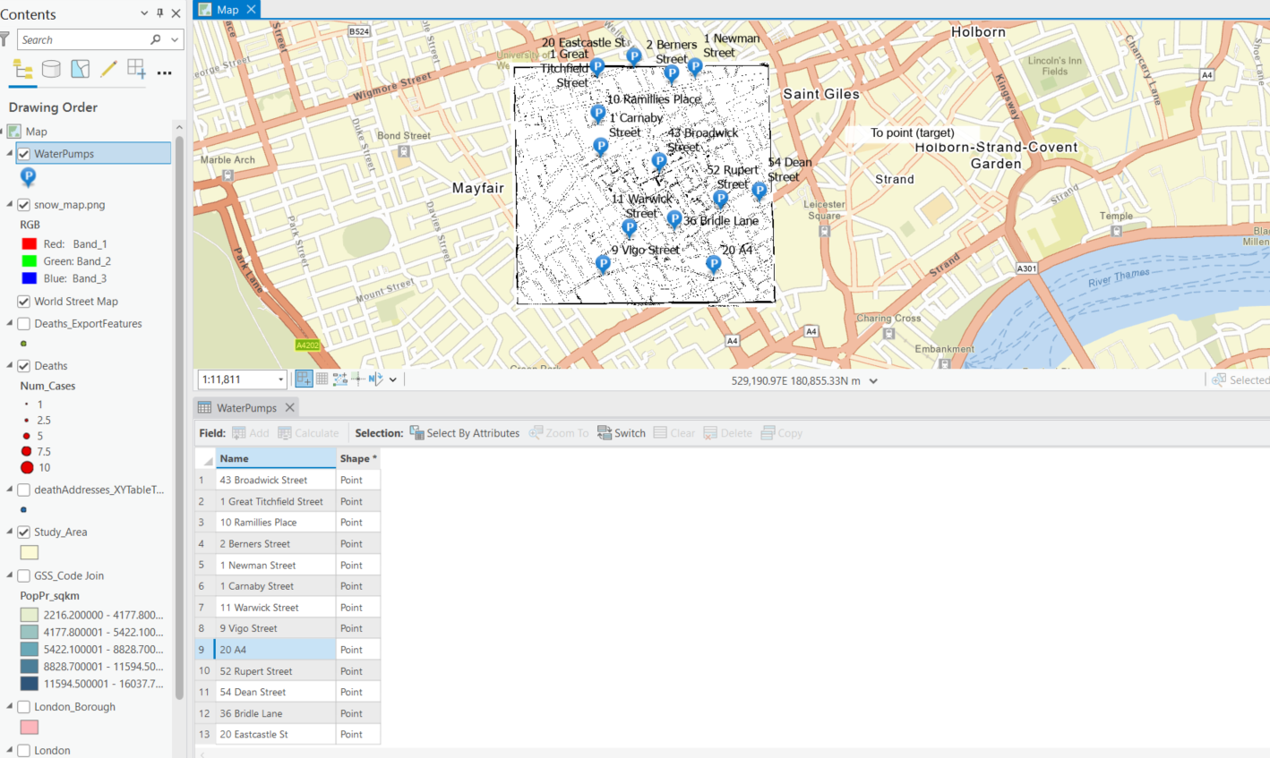
Labeled Water Pumps
Dir. f Sales
Dir. of Engineering
North America Lad
Europe Lead
Back End Lead

Slide 7
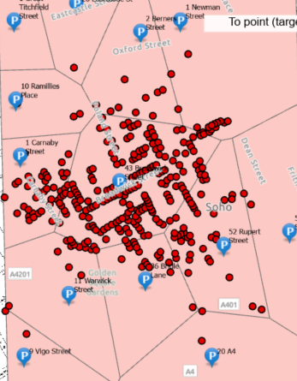
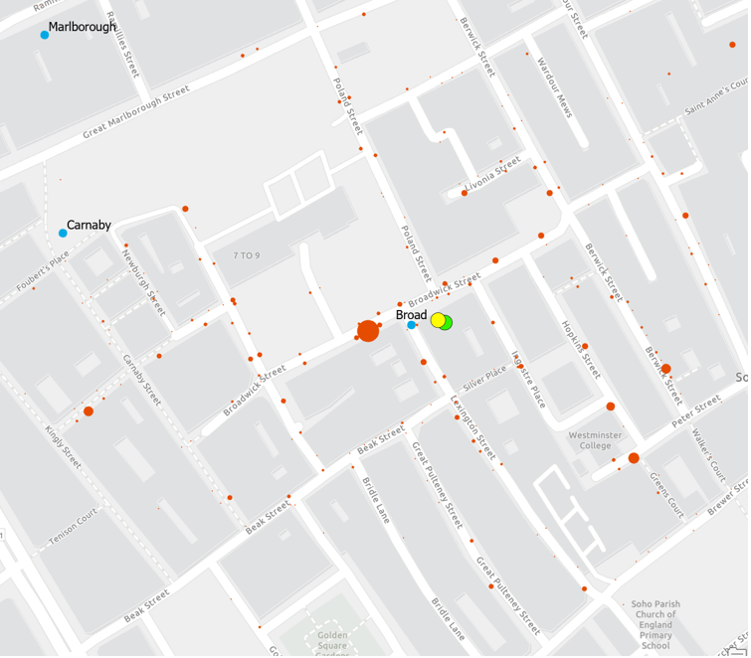
Theissen Polygons &
Weighted Means

Slide 8
Final Death Case Analysis

